Slide 1
Detecting COVID-19 and Other Respiratory Conditions Using Deep Learning Image Classification on Chest X-Ray Scans
Deep Learning Project - HIT
Roni Shternberg
Adir Leibovich
July 2023
Link to notebook

Slide 2
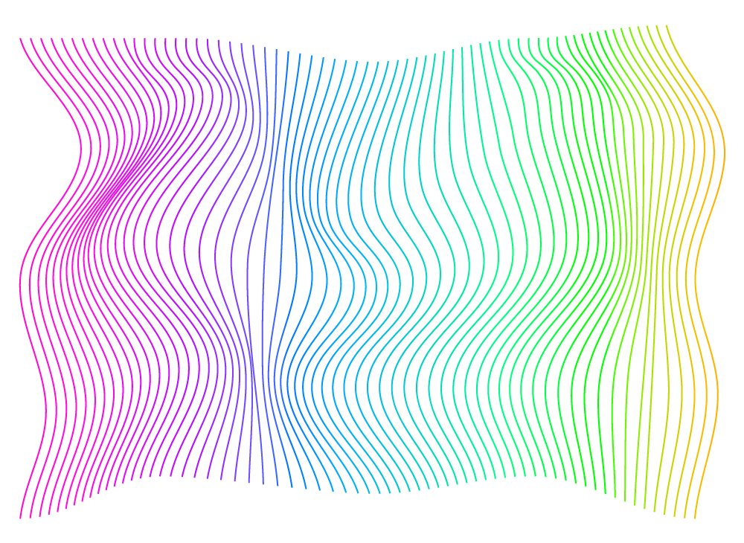
INTRODUCTION
This project leverages deep learning models to classify Chest X-ray (CXR) scans into four categories - COVID-19 positive, Normal, Lung Opacity (Non-COVID lung infection), and Viral Pneumonia. The ResNet-18, ResNet-50, VGG19 and DenseNet-121 models, pre-trained on the ImageNet dataset (with millions of images), are employed for this task. A systematic methodology involving image preprocessing, data augmentation, model training, hyperparameter tuning, and model evaluation is used. The study uses the "COVID-19 Radiography Database" from Kaggle, containing a total of 21,165 cases, in PNG format 256X256, the images distributions:
1. 3616 COVID-19 positive cases
2. 10,192 Normal cases
3. 6012 Lung Opacity (Non-COVID lung infection)
4. 1345 Viral Pneumonia cases
Citations:
- Article (1): "Can AI Help in Screening Viral and COVID-19 Pneumonia?"
- Article (2): "Exploring the effect of image enhancement techniques on COVID-19 detection using chest X-ray images"

Slide 3
- ResNet, or Residual Network, is a deep learning model that introduced the concept of skip connections or shortcuts to prevent the problem of vanishing gradient during training. - ResNet-18 is a version of this network that contains 18 layers, making it one of the smaller and computationally efficient variants of ResNet. This is particularly useful when dealing with large datasets, as in the case of our project, where we process thousands of images. - Despite its smaller size, ResNet-18 can still capture complex patterns in the data and perform well on various tasks, which makes it a suitable choice for initial exploratory analysis in this project.
ResNet-18

Slide 4
ResNet-50
- ResNet-50 is a larger variant of ResNet, with 50 layers, offering a more complex model that can capture even more intricate patterns in the data.
- While it requires more computational power than ResNet-18, it also tends to yield better results, especially in cases where the data is complex and varied.
- In the context of our project, this model can be beneficial in capturing the subtleties in CXR scans, which can be crucial in distinguishing between different conditions.

Slide 5
VGG19
- VGG19 is a deep learning model that is known for its simplicity and effectiveness. It comprises 19 layers and is characterized by its use of small (3x3) convolution filters, which allows it to capture local features in the image more effectively.
- It has been widely used in the field of image classification and has demonstrated excellent performance. Despite its increased computational demand compared to the ResNet models, it was included in this project to provide a comparative study between architectures that adopt different design principles.

Slide 6
DenseNet-121
- DenseNet is a CNN architecture where each layer is directly connected to every other layer in a feed-forward fashion (within each Dense Block). For each layer, the feature maps of all preceding layers are treated as separate inputs whereas its own feature maps are passed on as inputs to all subsequent layers.
- This architecture has a compact and efficient structure. It enables better gradient flow (alleviating the vanishing-gradient problem), strengthened feature propagation and improved feature reuse.
- This connectivity pattern yields state-of-the-art accuracies on CIFAR10/100 (with or without data augmentation) and SVHN. On the large scale ILSVRC 2012 (ImageNet) dataset, DenseNet achieves a similar accuracy as ResNet, but using less than half the amount of parameters and roughly half the number of FLOPs.

Slide 7
Deep Learning Pipeline
Step 1
Import Dependencies. Set Device (CPU/GPU)
Step 2
Load Data
Load Excel Metadata files, Create Test Folders, Move 20% of Files from Train to Test Folders
Step 3
Create Dataset
Initialize Dataset (with image transformations), Define Get Item method
Step 4
Define Transformations
Training Data Transformation, Test Data Transformation
Step 5
Prepare DataLoaders
Train and Test Data Loaders
Step 6
Define Loss Function
CrossEntropyLoss
Step 7
Model Definition
Step 8
Define Optimizers
For each model, an Adam optimizer is defined with a specific learning rate
Step 9
Show_preds() Function Definition
Define a function to show model's predictions
Step 10
Training Function Definition
Define a function that trains the model, evaluates it on the test set, prints results, shows predictions at each step, implements early stopping based on validation accuracy and loss, and saves the model state if validation loss doesn't decrease
Step 11
Model Training and prediction
Each model (ResNet18, ResNet50, VGG19, DenseNet121) is trained using the defined training function
ResNet18, ResNet50, VGG19, DenseNet121. Modify the last layer of each model to match the number of target classes

Slide 8
Project results
Model Name | Class | Precision | Recall | F1-Score
Residual Neural Network-18 (ResNet-18) Wall Time Running 35 minutes | COVID-19 | 0.63 | 0.77 | 0.69
 | Viral Pneumonia | 0.94 | 0.89 | 0.91
 | Lung Opacity | 0.72 | 0.78 | 0.75
 | Normal cases | 0.79 | 0.77 | 0.69
Residual Neural Network-50 (ResNet-50) Wall Time Running 47 minutes | COVID-19 | 0.67 | 0.55 | 0.61
 | Viral Pneumonia | 0.87 | 0.89 | 0.88
 | Lung Opacity | 0.67 | 0.71 | 0.69
 | Normal cases | 0.61 | 0.55 | 0.61
Visual Geometry Group 19 (VGG19) Wall Time Running > 4 Hours | COVID-19 | 0.52 | 0.45 | 0.48
 | Viral Pneumonia | 0.65 | 0.89 | 0.75
 | Lung Opacity | 0.55 | 0.65 | 0.59
 | Normal cases | 0.68 | 0.38 | 0.49
Dense Convolutional Network (DenseNet-121) Wall Time Running 1 Hours 40 Minutes | COVID-19 | 0.78 | 0.67 | 0.72
 | Viral Pneumonia | 0.86 | 0.89 | 0.87
 | Lung Opacity | 0.83 | 0.64 | 0.72
 | Normal cases | 0.57 | 0.76 | 0.65

Slide 9
CONCLUSIONS
1. The ResNet-18 model has an average f1 score of 0.76. While it demonstrated improved performance across all classes except COIVD-19 compared to the other models (0.69 vs 0.72 in DenseNet-121), it still showed some difficulty accurately classifying 'COVID' and 'Normal' images, as demonstrated by the relatively lower F1-scores and the confusion matrix.
2. VGG19 had a lower overall accuracy of 0.59. Its performance was particularly weak for the 'COVID' and 'Normal' classes, as indicated by the lower F1-scores of 0.48 and 0.49, respectively. The confusion matrix supports this, revealing a higher rate of misclassification for these two classes.
3. ResNet-50 achieved an overall accuracy of 0.71 and showed relatively balanced performance across all classes. However, it demonstrated some challenges in distinguishing between 'COVID', 'Normal', and 'Lung_Opacity' classes.
4. The DenseNet-121 model showed improved performance on the COVID-19 class (0.72 vs 0.69 in ResNet-18) but was slightly inferior to the Resnet-18 in the other classes.
Based on these results, one possible conclusion is that the ResNet18 model is the best performer among the four for this specific task. This could be due to the ability of ResNet18 to capture important image features more effectively than the other models. The specific architecture of ResNet18, which includes skip connections to avoid the problem of vanishing gradients, might be better suited for this image classification task.

Slide 10
To improve the models' performance in future work, there are several potential strategies: 1. Data Augmentation: Augmenting the dataset by introducing variations of the existing images (such as rotated or zoomed images) can help make the model more robust to different image representations. 2. Hyperparameter Tuning (using Grid Search or Optuna): Tuning hyperparameters like learning rate, batch size, and number of epochs can often lead to better performance. 3. Ensemble Methods: Combining the predictions from different models can often lead to better performance than any single model. 4. Additional Data: If possible, gathering additional labeled data for the 'COVID' and 'Normal' classes could help improve performance. 5. Model Architecture Adjustments: It might be beneficial to experiment with different layers or activation functions to see if they can better capture the relevant patterns in the data. 6. Trying different architectures: such as ResNet-101 and EfficientNet.
Further steps

